Slide 1
CNR ICT Department ISTI Institute CNR Research area, pisa, italy
Dr. Erina Ferro
Erina.Ferro@isti.cnr.it
www.isti.cnr.it

Slide 2
National Research Council (CNR)
What CNR is?
The National Research Council (CNR) is a public governmental organization.
Its duty is to carry out, promote, spread, transfer, and improve research activities in the main sectors of knowledge growth and its applications for the scientific, technological, economic and social development of the Country.
The CNR Scientific Network
One of CNR institutional duties is carrying out research activities in pursuit of excellence and strategic relevance within the national and international ambit, through its network of research institutes.
The network of CNR is constituted by 107 institutes, which are distributed all over the national territory. CNR is a is a multidisciplinary organization: it has competences in the field of health and biology, computer science, telecommunications, environment and climate, chemistry and physics, behavioral, economic and social sciences.
About 12000 researchers are employed in the 107 Institutes. About 700 administrative people work in the Headquarter, in Rome.
The scientific network in CNR is organized in 11 Departments, each one devoted to a specific research area.
Each department:
includes a certain number of Institutes, or parts of them.
is organized in a certain number of “thematic sectors” or “projects”
ISTI institute belongs to the ICT (Information and Communication Technologies) Department.

Slide 3
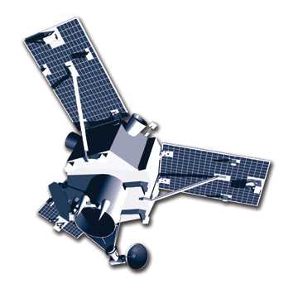
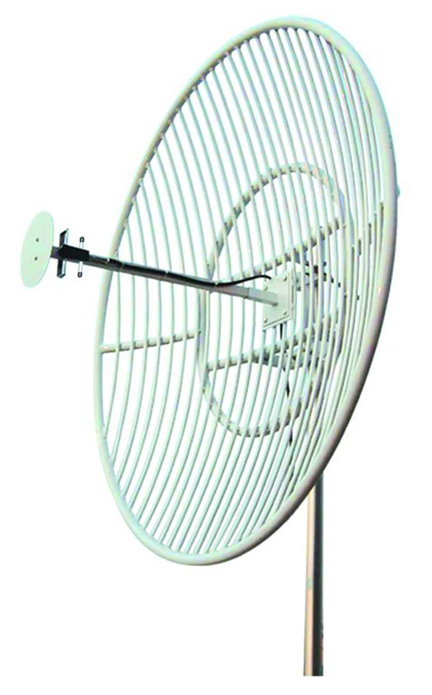
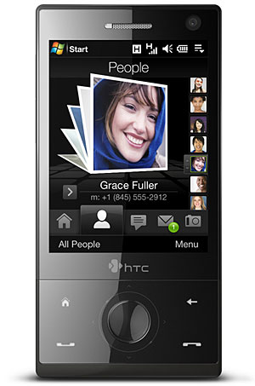
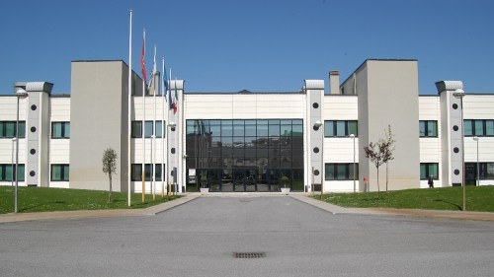
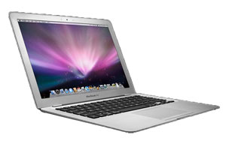
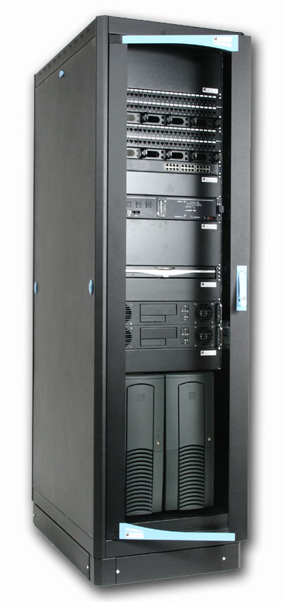
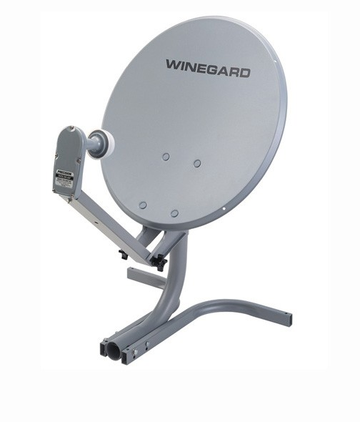
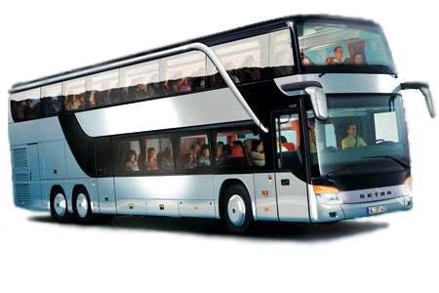
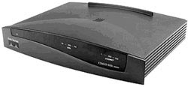
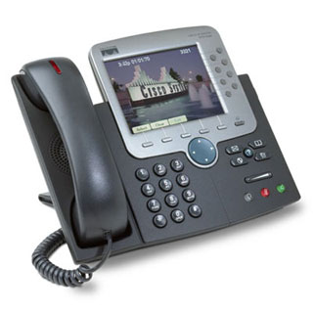
ISTI - Wireless Networks Laboratory
satellite communications, wireless terrestrial networks, sensor networks, heterogeneous networks, middleware solutions based on OSGI (Open Service Gateway Initiative) platform

Slide 4
Our contribution in Streaming of multimedia entertainment Contents and info Retrieval within heterogeneous Mobile environments
Wireless Networks Lab @ ISTI CNR
Notes:
Tecnologie per la trasmissione affidabile di dati che vede come fulcro della comunicazione I veicoli urbani che funzionano da gateway mobili.
Collezionare dati sull’ambiente, il traffico, inquinamento e trasmetterlo a centrali operative o service providers
Riceve contenuti multimediali per l’intrattenimento e l’informazione e riditribuirlo a bordo o in prossimità del veicolo

Slide 5
OUTLINE
System Description
Channel Model
Technical solutions
Error recovery:
Upper Layer Forward Error Correction
Interleaving
Delay adaptation & Bandwidth saving:
Smart Buffering (by GPS route prevision)
Optimized Packet Scheduling
Security

Slide 6
Network overlay
Broadcast Net
WIMAX Access Net (To Internet)
WSN
Local WiFi Net
WSN
WSN
WSN
Local WiFi Net
Local WiFi Net
WSN
WSN

Slide 7
Services and technologies
Entertainment
Positioning & Geotagging (GPS)
Multimedia Broadcasting (DVB-xx)
Podcasting and Sharing (WiMAX, UMTS, HSPA)
Data Retrieving (Zigbee - 802.15.4)
Monitoring & Surveillance
Pollution
Traffic jam

Slide 8
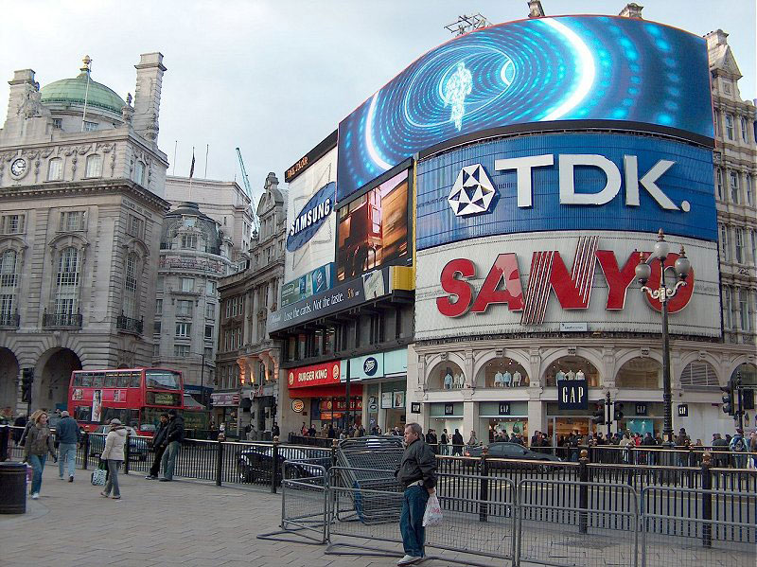
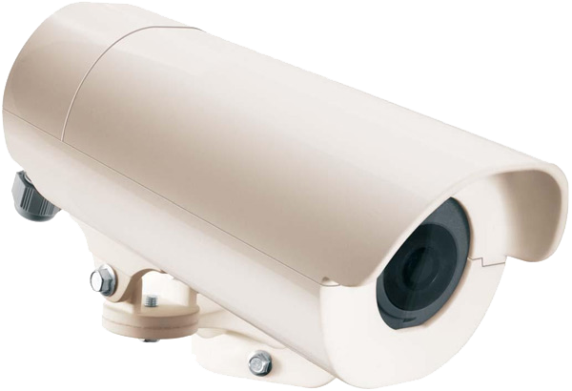
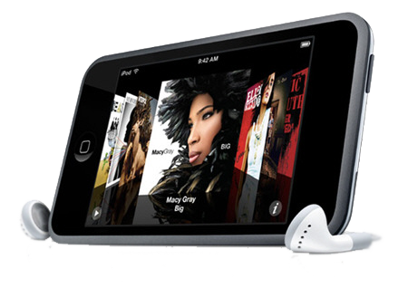
Scenario
GEO
tagging
GPS positioning
Surveillance
&
Monitoring
On Board Entertainment
Fleet of busses
Neighbouring Adv

Slide 9
Channel Model (Land mobile satellite & terrestrial wireless channel)
On–Off channel behaviour in wireless communication
Signal Interference
Multipath Fading
Obstacles (tunnel, buildings, etc.)
Large end to end propagation delay in satellite communication with mobile and fixed terminals
Error recovery techniques become mandatory
End-user undergoes additive play-out delay due to error recovery techniques

Slide 10
DVB-RCS/S2 for mobile end-users
We started from ESA’s Land Mobile Satellite (LMS) channel model, expressed in Eb/No (propagation only)
We simulated (Matlab/Simulink) DVB-RCS/S2 chains
In each channel state (LoS, No-LoS), for a CBR flow, we computed:
Average Packet Error Rate
Average Burst Error Length
Traces of lost/correctly received packets
Based on simulation results, we derived a mobile channel description at packet level
From 3-state Discrete Markov Chain (ESA LMS) ⇨ 2-state Discrete Semi-Markov Chain (ON-OFF)

Slide 11
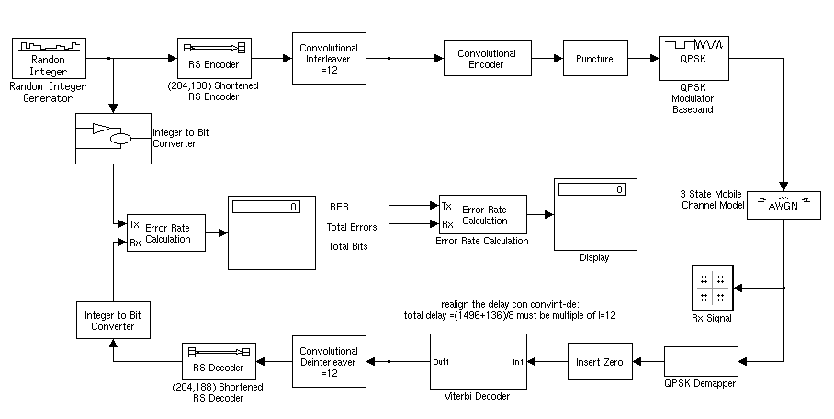
Model of packet error process
Developed the standard DVB-RCS/S2 bit-level processing chain:
Reed-Solomon Encoder,
LDPC Encoder,
Convolutional Interleaver,
Convolutional Encoder,
BCH Encoder,
Puncturing,
Modulations
Mobile channel model
Developed a LMS packet channel model in Ku band
It implements different noise patterns for each environment (LoS, NLoS)
It considers both directed and scattered radio signal components
Matlab-Simulink model for DVB-RCS link layer
Our GOAL is to assess the packet-level performance of DVB-RCS/S2 under mobile channel conditions

Slide 12
DVB-RCS for mobile users (uplink)
Significant differences in PER between LoS and NLoS states
Mobile channel in LoS is substantially different from AWGN
Minor differences (less than 1 dB) in PER for each state in different environments

Slide 13
DVB-S2 for mobile users (downlink)
PER curves are very steep in LoS environment
Significant differences in PER between LoS and NLoS states
PER curves strongly dependent on MODCOD

Slide 14
Solutions & Optimizations
Error recovery:
Upper Layer Forward Error Correction
Interleaving
Delay adaptation & Bandwidth saving:
Smart Buffering (by GPS route prevision)
Optimized Packet Scheduling

Slide 15
UPPER Layer FEC
ULFEC:
k
Data Packets
h
Redundancy
n = k+h
Transmission
(perhaps with packet loss)
X
X
X
Reconstruction of the complete sequence

Slide 16
Packet layer Interleaving
Interleaving in order to reduce error burst length
Interleaving adds a significant delivery delay
Interleaving helps in reducing the PLFEC codeword and the relative decoding complexity

Slide 17
ULFEC and INTERLEAVING
Codeword:
4 Info packets
2 Redundancy pkts
1A
2A
3A
4A
5A
6A
1B
2B
3B
4B
5B
6B
1C
2C
…
1D
2D
…
1A
1B
1C
1D
2A
2B
2C
2D

Slide 18
SMART Buffering
Long blockage periods (tunnels, bridges, trees…) may lead to complete channel outage
The loss of all packets transmitted during a long period may overcome the correcting capacity of the code.
When the routes are well-known, as when traced by means of a GPS navigator, these periods may be predictable.
The Smart System takes advantage from the combined action of GPS navigator, ULFEC, Interleaving and smart buffering, by estimating the points where the vehicle will not receive the signal for a period that exceeds a given threshold; in fact, this knowledge allows avoiding the transmission of data toward the specific bus, thus temporarily saving bandwidth for other services

Slide 19
SMART Buffering

Slide 20
SMART Buffering
The beginning of the video reproduction is delayed by the Stdelay filling time at speed r_{n}:
Stdelay: the maximum time the user could accept to delay the play-out. This delay is composed by two components:
Tstore: the time used by the smart system in order to pre-buffer the video content;
Interleaving Time: the delay introduced by the interleaver in order to spread bad packets (erasures) over a larger dominion.
When, along the route, a channel blockage is longer than maxtb, a stop signal is sent to the the hub in suitable advance; the hub suspends the transmission, just saving bandwidth!
When the blockage is overcome, the end-user requires the hub to resume transmission at r_{h} speed, up to the complete refilling of the end-user buffer.

Slide 21
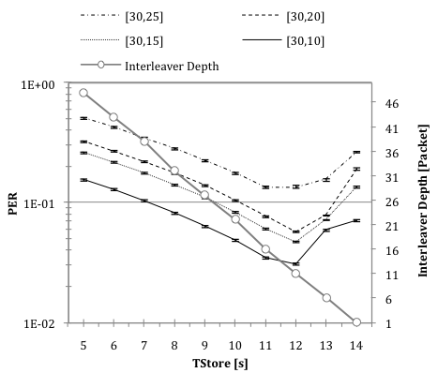
SMART Buffering
ORIGINAL
Stdelay 15s
SM [30/10]
Notes:
Graph shows the packet error rate as a function of the time used for the pre-buffering (Tstore). The maximum play-out delay is 15s. The residual time between play-out delay and pre-buffering is due to the interleaver depth.

Slide 22
Methodology: Cost Function Optimization
Input traffic
Centralized Controller
Queues State
Queues Set
We use a small signal linearization of queues’ equations around a set-point
Action delay
Informdelay
Centralized controller
By Little’s law, the goal of attaining a target on average delay translates into a goal of attaining an average queue length
Controller
System
observer
Assigned rate
The goal is to minimize an objective function that weighs the difference from the designed targets (i.e., the average delay for each video flow), taking into account the gaps between current and target
Individual queue lengths
Individual bandwidth allocation to services
Overall bandwidth allocation

Slide 23
Bandwidth-Delay Tradeoff (simulations)
We compare two approaches in allocating bandwidth to the flows:
Separate control of queues: each queue is controlled independently of the others
Combined control of queues: the overall bandwidth allocation cost is considered
Varying the weight associated to individual bandwidth cost we can trade overall bandwidth allocation jitter for queue size jitter
The combined control of queues allows us to reduce queue length jitter for a given distribution of total bandwidth allocation with both correlated and uncorrelated traffic

Slide 24
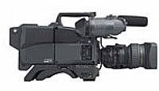
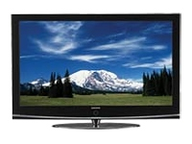
Authentication of Video Stream
Video streaming as a reliable one-way comunication channel
Hidden
Information
Hidden
Information

Slide 25
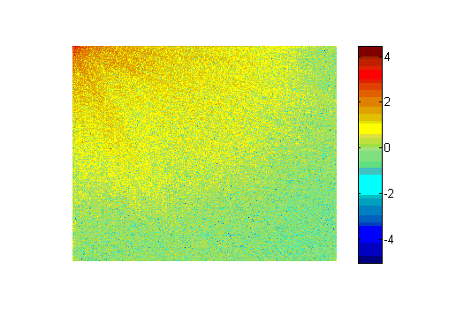
Authentication of Video Stream
Hidden channel usability
Security information
Meta Data
Hidden
Information
Important features
No bandwidth overhead
Low computational overhead
(MPEG transcoding complexity)
Functional independence of lower
layers (transport, network, and physical)

Slide 26
HARD Authentication of Video Stream
Back-off hashing algorithm
SENDER
Offline pre-processing:
Back-off algorithm in order to compute the hash chain
Signature amortization by means of the hash chain
Only a single Digital Signature computed on the first GOP₀
RECEIVER
Real-Time video authentication:
Validating the video stream GOP by GOP
Hard Authentication:
Single bit corruption prevents its GOP authentication

Slide 27
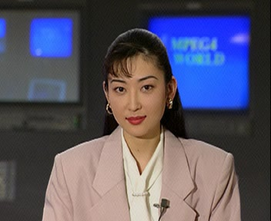
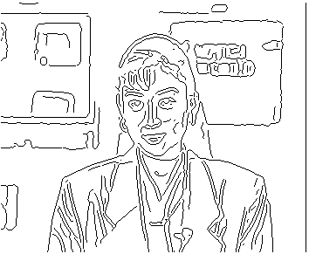
Fragile Authentication of Video Stream
Research activity:
Fragile authentication by means of features extraction:
Authentication of picture edges
Packet loss robustness
Transcoding robustness
Edge detection

Slide 28
For any contact……..
Dr. Erina Ferro
erina.ferro@isti.cnr.it
Dr. Alberto Gotta
alberto.gotta@isti.cnr.it

