Slide 1
Architectures, Techniques and Methods for Resource Discovery
Michele Girolami
Ph.D. Lunchtime Seminars
2012
Notes:
someone prefer to switch to english or italian is ok?

Slide 2
about me
Wireless Networks Laboratory (WN)
Research interests:
Pervasive and Ubiquitous Computing
Formal models for Service Discovery in distributed environments
Wireless Sensor Networks
802.15.4 and ZigBee

Slide 3
Index
Introduction
Resource Discovery Architectures
Resource Discovery Techniques
Resource Discovery Methods
Clustering and Overlay Networks
Dedicated Frameworks
Open issues in Resource Discovery
Bibliography
Notes:
This seminar aims at providing a first introduction to the resource discovery

Slide 4
1. Introduction Resource and Service Discovery
A Resource is any source of supply:
File-system
Memory space
CPU capability
that can be provided as a Service
The Resource Discovery (RD) is any mechanism that is providing capability to locate a resource in the network
RD
SD
K. Vanthournout, G. Deconinck, R. Belmans, A taxonomy for resource
discovery, Personal Ubiquitous Computing 9 (2) (2005) 81–89.
Notes:
Any kind of entity that can be provided as a service -> accessible from other clients

Slide 5
1. Introduction Resource and Service Discovery
Goal of RD is to:
advertise clients of the availability of a specific resource in the network
provide a pointer to the resource (ie. the URL to the resource provider)
RD
SD

Slide 6
1. Introduction Resource Discovery Design
Centralized vs decentralized architectures
Search technique and the query matching strategy
Network topology (ie. star, tree or mesh topologies)
Scale of the network:
internet-scale
enterprise-scale system
local-scale systems

Slide 7
1. Introduction Resource Discovery Process
To advertise the resources
To query about the resources provided by the providers
To select the most suitable resource
To access to the resource
Advertisement
Query
Selection
Access

Slide 8
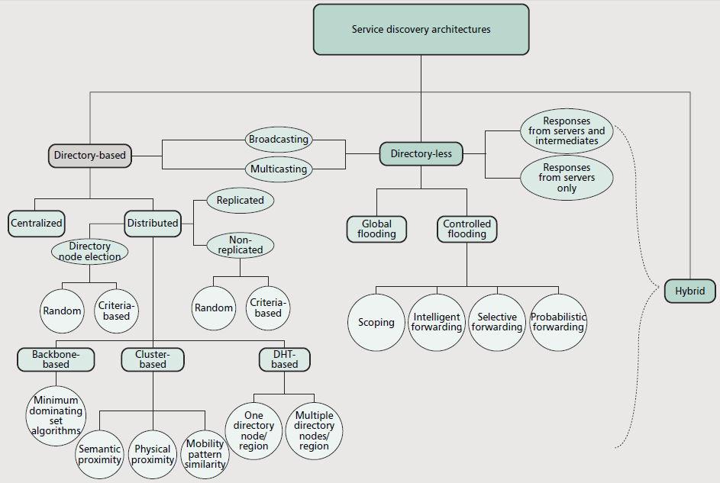
1. Introduction The Big Picture
Notes:
Jini Sun 1998

Slide 9
Index
Introduction
Resource Discovery Architectures
Resource Discovery Techniques
Resource Discovery Methods
Clustering and Overlay Networks
Dedicated Frameworks
Open issues in Resource Discovery
Bibliography

Slide 10
2. RD Architectures Centralized Architecture
Resource Directory: collects the information about the resources available on the network
Resource Provider: advertises the resource (adv) to the Resource Directory
Resource Client: queries the Service Directory for a specific resource and accesses the Service Provider
Node | Advertisements
i | $${adv}_{h},{adv}_{k}$$
j | $${adv}_{x},{adv}_{y}$$
$${adv}_{k}$$
$$q_{k}$$
i
$${adv}_{k}$$

Slide 11
2. RD Architectures Centralized Architecture
Centralized Architecture
Highly centralized
Auto-configure centralized
Static configuration:
directory pre-configured
clients know the RD URLs
directory must be always reachable
Variable number of RD nodes
can be dynamically elected
can be removed or added
need a synchronization strategy
or replicas
Dynamic configuration:
Clients discovers the directory with
ie. m-cast or b-cast announces

Slide 12
2. RD Architectures Centralized Architecture
Node | Advertisements
i | $${adv}_{h},{adv}_{k}$$
j | $${adv}_{x},{adv}_{y}$$
Directory
j
j
i
Node | Advs
i | […]
j | […]
i
U. C. Kozat and L. Tassiulas, “Service Discovery in Mobile Ad
Hoc Networks: An Overall Perspective on Architectural Choices
and Network Layer Support Issues,” Ad Hoc Networks, vol. 2,
no. 1, 2004, pp. 23–44.
Notes:
tratteggio

Slide 13
2. RD Architectures Decentralized Architecture
Resource Provider: announces the availability of the resources to the whole network or answers to the client queries
Resource Client: injects the queries into the network waiting for a response

Slide 14
2. RD Architectures Decentralized Architecture
$$q_{k}=\left\{ \begin{aligned}type=k \\ access cost=c \\ \begin{aligned}location=\left[x_{1},y_{1}\right],\left[x_{2},y_{2}\right], \\ \left[x_{3},y_{3}\right],\left[x_{4},y_{4}\right]\end{aligned}\end{aligned}\right.$$
$$r_{k}$$
$$q_{k}$$
$$r_{k}$$
$$q_{k}$$
$$q_{k}$$
$${adv}_{k}$$
$${adv}_{k}$$
$$q_{k}$$
$${adv}_{k}$$
$${adv}_{k}=\left\{\begin{aligned}type=k \\ access cost=d \\ location=[x,y] \\ URL\end{aligned}\right.$$
$$q_{k}$$
$${adv}_{k}$$
$$q_{k}$$
$$q_{k}$$
$${adv}_{k}$$

Slide 15
Index
Introduction
Resource Discovery Architectures
Resource Discovery Techniques
Resource Discovery Methods
Clustering and Overlay Networks
Dedicated Frameworks
Open issues in Resource Discovery
Bibliography

Slide 16
3. RD Techniques Packet Propagation
How to propagate packets containing the queries into the network
The choice of the best propagation method depends on:
Underlying network topology
Communication media
Scale of the network

Slide 17
3. RD Techniques Packet Propagation
Unicast
1 sender to 1 receiver
E.g. the query is sent to one directory
Broadcast
1 sender to all receivers
E.g. the query is sent to all the providers

Slide 18
3. RD Techniques Packet Propagation
Multicast
1 sender to many receivers
E.g. providers and clients join some groups of interest
$q_{k}$ is only forwarded to the providers belonging to group k
Anycast
1 sender to many top-receivers
The receivers are chosen according to several metrics like:
Closeness to the sender
Minimal load

Slide 19
3. RD Techniques Discovery Modes
How clients learn about the resources the network provide
The choice of the best discovery mode depends on:
Network density
Number of available resources
Popularity of the resources

Slide 20
3. RD Techniques Discovery Modes
$$q_{k}$$
Reactive
Clients explicitly send a query to the directory agent(s) or to a set of providers
Proactive
Clients receive resource advertisements without asking for them
Providers announce/refresh the resources as soon as they are available
$${adv}_{k}$$
$${adv}_{k}$$
$${adv}_{k}$$

Slide 21
3. RD Techniques Information Delivery Modes
How to share information about resources in the network by reducing the packet propagation
Caching
Nodes cache successive resource advertisements in order not to repeat the search later
To manage stale-information stored in the cache
To keep multiple cache instances: on the resource clients and on the intermediate nodes
Hello Messages
The information stored in the cache require to be updated by regular Hello messages
To tune the message rate in order to avoid much of overhead
To forward the messages only to 1-2 hop neighbours

Slide 22
3. RD Techniques Information Delivery Modes
Piggybacking
To exploit existing protocols in order to deliver information about available/unavailable resources:
routing packets by adding an extra payload delivering resource information
to manage constraints on the maximum packet size used in different environments on physical layer
Sotirios E. Athanaileas, Christopher N. Ververidis and George C. Polyzos, Optimized Service Selection for MANETs using an AODV-based Service Discovery Protocol

Slide 23
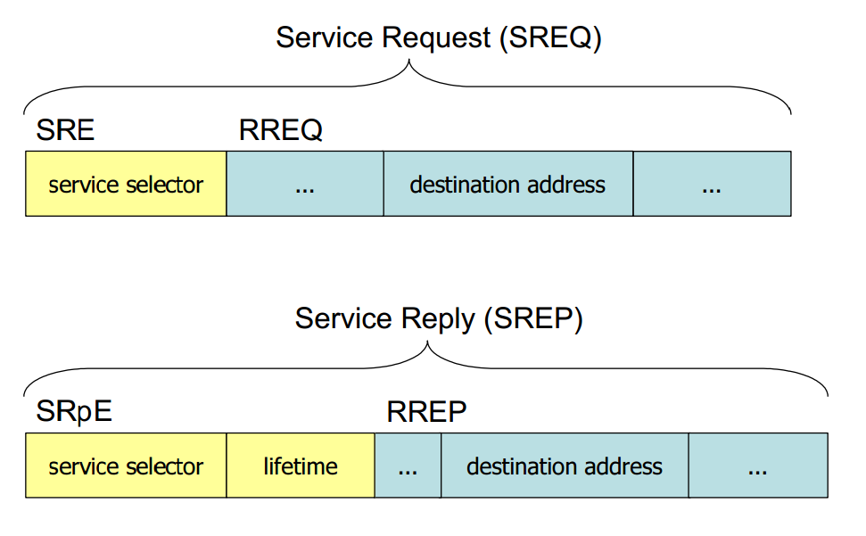
3. RD Techniques Information Delivery Modes
AODV popular routing protocol for MANET
RREQ
RRESP
AODV messages extended with
SREQ: service request
SREP: service reply

Slide 24
3. RD Techniques Query Termination
The packet propagation injects a number of queries into the network
If the response has been received, all the running queries have to be terminated by avoiding:
network overhead
computation of intermediated and target nodes
If the response has not been already received nothing is done
$$q_{k}$$
$$q_{k}$$
$${adv}_{k}$$
$$q_{k}$$

Slide 25
3. RD Techniques Query Termination
Iterative deepening
TTL = 2
TTL = 1
$${adv}_{k}$$

Slide 26
3. RD Techniques Query Termination
Iterative deepening
A number of successive floods span the network by carrying the query
TTL value of the flood increases
If the resource is discovered the flood iterations are suspended
Otherwise a new flood with TTL increased is sent
The search diameter grows with the TTL value
Performs well for popular resources (hosted by lot of provider)
Not suitable for rare resources since big and useless area of the network are explored

Slide 27
3. RD Techniques Query Termination
Checking
$$j$$
$$k$$
TTL = 2
$$checking$$
$$m$$
$$i$$
$$checking$$
$${adv}_{k}$$

Slide 28
3. RD Techniques Query Termination
Checking
The query replicas are sent to a number of neighbours randomly selected
The query is forwarded toward the destination until the TTL >0
When TTL = 0, the intermediate node sends a checking packet to the source
If the query is not answered the propagation continues with TTL renewed
Otherwise the query is terminated
Notes:
The tech, that we have seen give you the possibility to locate a provider by once it has been found it necessary to find a path from the source to the destination.

Slide 29
Index
Introduction
Resource Discovery Architectures
Resource Discovery Techniques
Resource Discovery Methods
Clustering and Overlay Networks
Dedicated Frameworks
Open issues in Resource Discovery
Bibliography

Slide 30
4. Resource Discovery Methods
To find a path from the source to the destination node
The source is the clients submitting the query
The destination is the provider hosting the resource
The path can be evaluated according to the cost of search:
Path length in terms of number of hops
Number of packets sent in order to reach the provider
Energy cost in order to access to the provider

Slide 31
4. Resource Discovery Methods
Uninformed methods
The search is approached without any information on the network
Systematic: the search follows a predefined approach
Random: the search is based on a random variable
Informed methods
The search is approached by exploiting partial information on the network
Extensive use of heuristics that can lead the query to a node providing the resource
Notes:
Such information has bee acquired during the time or pre-configured
The techniques we have reviewed aim at propagating persiting or killing the information about the services. But once we have found the provide we have to find a path from the source (the client) to the destination (the provider).
A number of methods exist in order to find a path from the source to the destination node
The source is the clients submitting the query
The destination is the provider hosting the resource
The path can be evaluated according to the cost of search:
Path length in terms of number of hops
Number of packets sent in order to reach the provider
Energy cost in order to access to the provider

Slide 32
4. Resource Discovery Methods Uninformed systematic
BFS
DFS and variants
Limited DFS allows to pre-set the
depth of the search
Iterative DFS exploits the limited DFS
At each run the depth value is increased by visiting providers far from the root
4
5
6
7
1
2
3
2
3
1
4

Slide 33
4. Resource Discovery Methods Uninformed systematic
Uniform-cost
To select the neighbours with lowest path cost, the search starts by exploring all the neighbours and selecting the one with lowest path cost
3
2
1
2
2
1
3

Slide 34
4. Resource Discovery Methods Uninformed random
Random walk
The source node sends a query to a number (pre-defined) of neighbors randomly selected
The number of query replicas does not increase with the hop distance
Probabilistic forwarding
For every node belonging to the set of out-neighbours the value $p$ = rand(0,1)
$p≥t →$ query forwarded to the node
Notes:
Methods governed by random variables. Good performance is expected, but not guaranteed by these algorithms.

Slide 35
4. Resource Discovery Methods Uninformed random
Probabilistic flooding
Based on flooding
The query replicas are forwarded with to the node’s neighbors with a percentage p
p = 1 is the standard flooding
p= 0 the propagation is stopped
Notes:
It is used in large dense wireless networks where the standard leads to huge overhead and increased the collision rate
By dynamically configuring the value of percentage p it is possible to increase the protocol efficiency.

Slide 36
4. Resource Discovery Methods Informed
Informed search method rely on some kinds of information:
Location
Traffic load
Available computational resources
Communication channel quality
Available bandwidth
Feedback considered as the percentage of success in providing a resource previously search with a query

Slide 37
4. Resource Discovery Methods Informed
Best-first
The methods evaluate a function $f$ on all the neighbours and selects the node with the best value of $f$.
A*
Based on the best-first with the function f :
$$f\left(n\right)=g\left(n\right)+h\left(n\right)$$
$g\left(n\right)$ = path-cost from the client to the mid-node
$h\left(n\right)$ = estimated path-cost from mid-node to the provider
Notes:
In the case of RD the function $f$ aims at estimate the cost from the current node to the solution
$g\left(n\right)+h\left(n\right)$ =cost sour-destination and back (h(n))
H(n) admissible not to over-estimate H*(n)

Slide 38
Index
Introduction
Resource Discovery Architectures
Resource Discovery Techniques
Resource Discovery Methods
Clustering and Overlay Networks
Dedicated Frameworks
Open issues in Resource Discovery
Bibliography

Slide 39
5. Clustering and overlay networks
To alter the network topology in order to increase the system performance
Nodes are organized in clusters sharing common properties
Queries and service advertisements are managed in an efficient way by the cluster
The Overlay Network
Network topology

Slide 40
5. Clustering and overlay networks Examples of clusters
Cluster Heads
$$q_{k}$$
$${adv}_{k}$$
$${adv}_{x}$$
$${adv}_{i}$$
$$q_{x}$$
$$q_{i}$$
$${adv}_{j}$$
$$q_{x}$$
${adv}_{k}$ = advertisement of resource k
$q_{k}$ = query for resource k

Slide 41
5. Clustering and overlay networks Examples of clusters
Examples of cluster rules:
Similarity on the services
Similar services within the same cluster
Location of the nodes
Nearby nodes within the same cluster
Quality of the service
Services with similar QoS parameters within the same cluster

Slide 42
Index
Introduction
Resource Discovery Architectures
Resource Discovery Techniques
Resource Discovery Methods
Clustering and Overlay Networks
Dedicated Frameworks
Open issues in Resource Discovery
Bibliography

Slide 43
6. Service Discovery frameworks
Review of widely used service discovery frameworks
Designed for administrated networks (hence not for p2p)
Centralized and decentralized architectures
SLP Service Location Protocol
UPnP Universal Plug and Play
Bluetooth Service Discovery
Bonjour

Slide 44
6. Service Discovery Frameworks SLP
SLP is an IETF standard
Defined by a number of RFCs (2165, 2608, 2609 and 2914)
SLP relies on a centralized architecture suitable for
Large-Enterprise networks
LAN
Supports 2 modes:
Centralized mode with Directory Agents (DAs)
Distributed mode without DAs

Slide 45
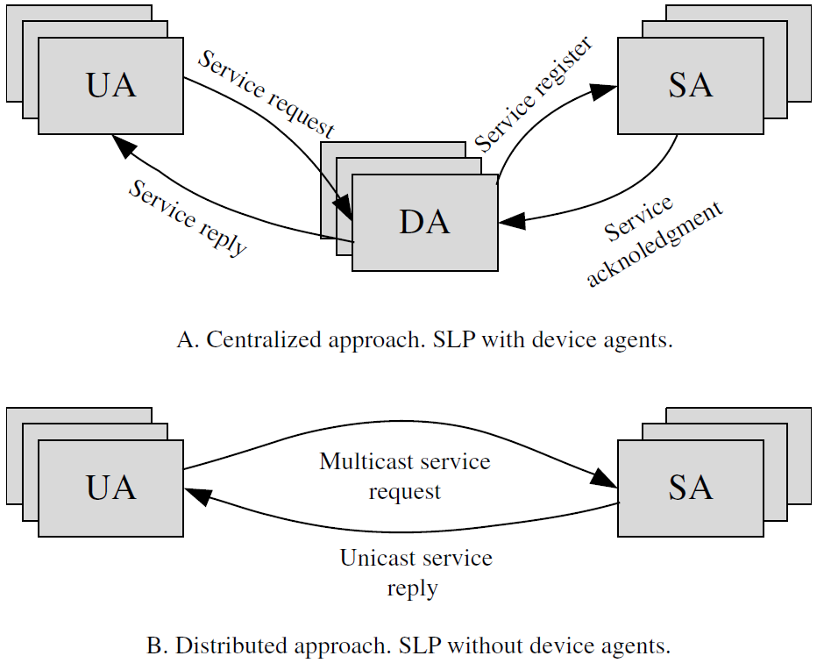
6. Service Discovery Frameworks SLP
Notes:
SLP uses UDP (port 427) and TCP
UAs first multicast a query to discover DAs
no answers within a timeout →switch to a decentralized architecture
If answer → switch to a centralized architecture
DAs can join later the network:
They must announce the presence actively with respect to SA e UA
UA queries for services without a DA by using mcast UDP
SA that provides a matching service replies to the UA
UA queries for services with DA by using unicast TCP or UDP
DA that provides such an advertisement replies to the UA

Slide 46
6. Service Discovery Frameworks SLP
The service replies contain:
URL service:servicename:protocolname://hostname.
Attributes: <key, value>
Scope: string classifying the services
UAs query the DA or SAs by specifying:
The type of the service
A list of attributes
The service scopes

Slide 47
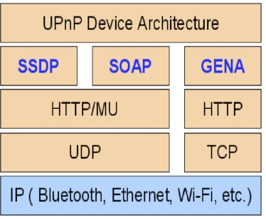
6. Service Discovery Frameworks UPnP
Universal Plug and Play FW defines a protocol stack for:
Addressing
Discovery
Description
Control
Eventing
Presentation

Slide 48
6. Service Discovery Frameworks UPnP
UPnP relies on the SSDP protocol for the discovery
Completely distributed query-based
Roles of nodes:
Control Points ($≅resource clients)$
Controlled Devices ($≅resource providers)$

Slide 49
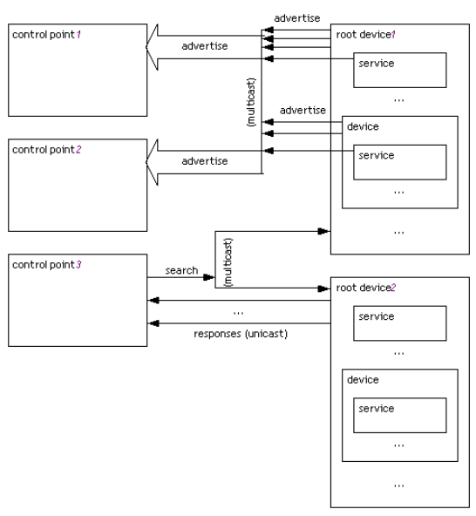
6. Service Discovery Frameworks UPnP

Slide 50
6. Service Discovery Frameworks UPnP
Controlled Devices receive an XML URL describing the Controlled Device
Every controlled device runs a HTTP server
XML document provides a tree-based description of the device
UPnP also defines:
how to access to the service
To invoke remote procedures through SOAP messages
how to be notified by the service
To register to the control variables and to receive asynchronous HTTP messages

Slide 51
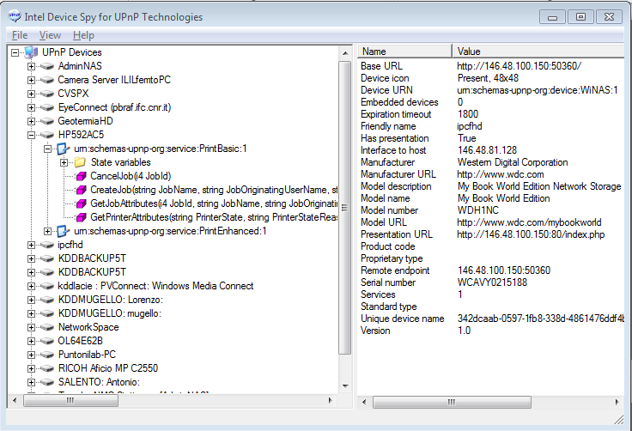
6. Service Discovery Frameworks UPnP

Slide 52
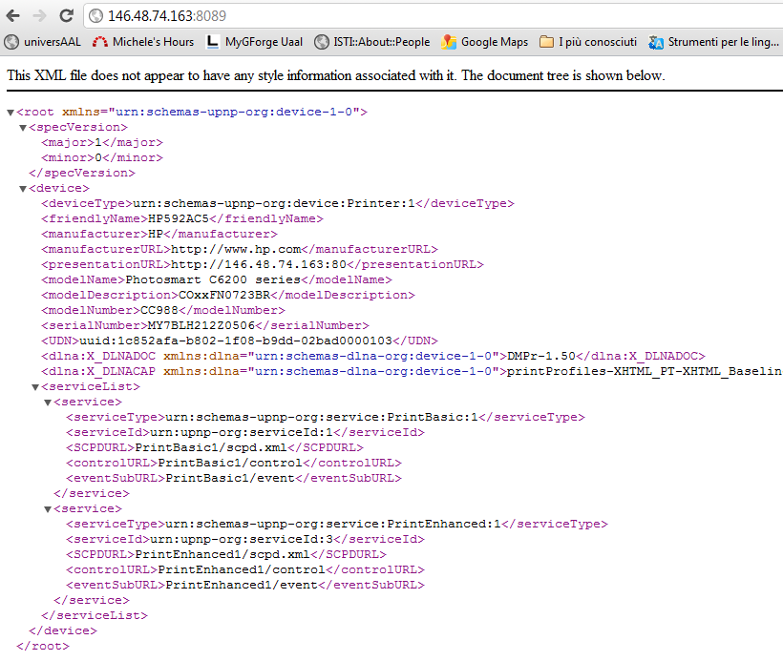
6. Service Discovery Frameworks UPnP

Slide 53
6. Service Discovery Frameworks Bluetooth Service Discovery
Bluetooth allows multiple devices to cooperate in a master-slave relationship
a Piconet composed of
1 master device
n slaves
Designed for resource-constrained environments and to spend minimal bandwidth
Bluetooth is not designed for IP-based networks
Service Discovery in Bluetooth is powered by SDP

Slide 54
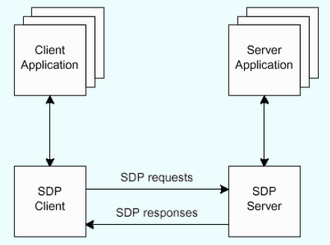
6. Service Discovery Frameworks Bluetooth Service Discovery
Each device can act as SDP client or server
Client discovers services provided by other devices
Service provides services
Every service is described by a service record (set of service attributes )
Every service belongs to a service class:
Type of the service
Set of attributes describing the specific serivice
Services and attributes are uniquely identified with pre-defined IDs

Slide 55
6. Service Discovery Frameworks Bluetooth Service Discovery
SDP defines 3 search modes
Service Search: to search for a specific service identified by an ID. The client will receive a bunch of service records
Attribute Search: to search for a set of attributes with respect to a specific service
Service and Attribute Search: to search for a service and to fetch a list of relevant attributes

Slide 56
6. Service Discovery Frameworks Bonjour
Bonjour protocol is promoted and supported by Apple
Successor of Appletalk
Implementation of Zeroconf IETF protocol
Bonjour is designed for local and ad-hoc IP-based networks
Decentralized architecture
Relies on multicast and DNS technologies
Bonjour covers 3 areas:
Addressing
Naming
Service Discovery

Slide 57
6. Service Discovery Frameworks Bonjour
Addressing allows to obtain an IP address via self-assigned link-local addressing
If DHCP is enabled an IP address is assigned
If DHCP is disabled the device randomly select an IP address and verifies if it is free
Naming allows to map name-to-address via mDNS protocol
DNS queries are sent in multicast in the local network
Every computer must have assigned a local name (only valid inside the local network)
Service Discovery allows to discover all the instances of a service a to maintain a named service
Via mDNS advertisement using a multicast address
Via mDNS query
Services are named with human-readable strings

Slide 58
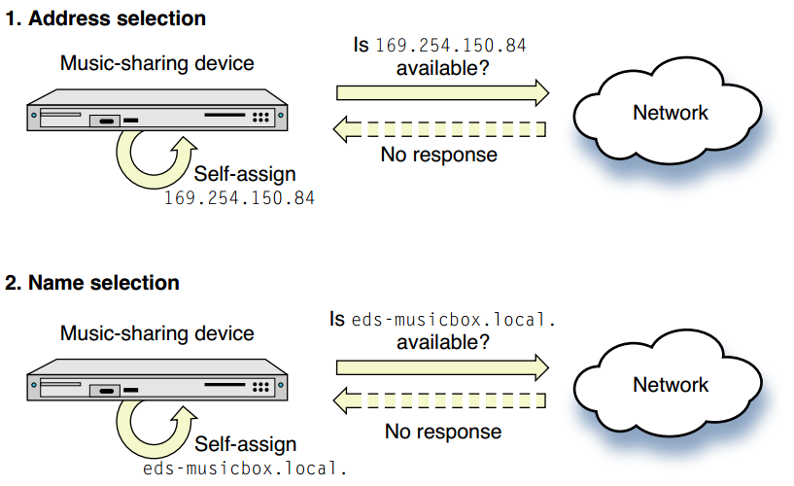
6. Service Discovery Frameworks Bonjour
https://developer.apple.com/library/mac/documentation/Cocoa/Conceptual/NetServices/NetServices.pdf

Slide 59
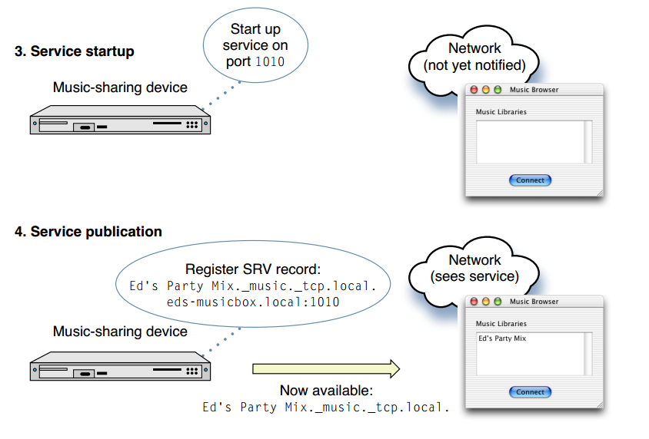
6. Service Discovery Frameworks Bonjour
https://developer.apple.com/library/mac/documentation/Cocoa/Conceptual/NetServices/NetServices.pdf

Slide 60
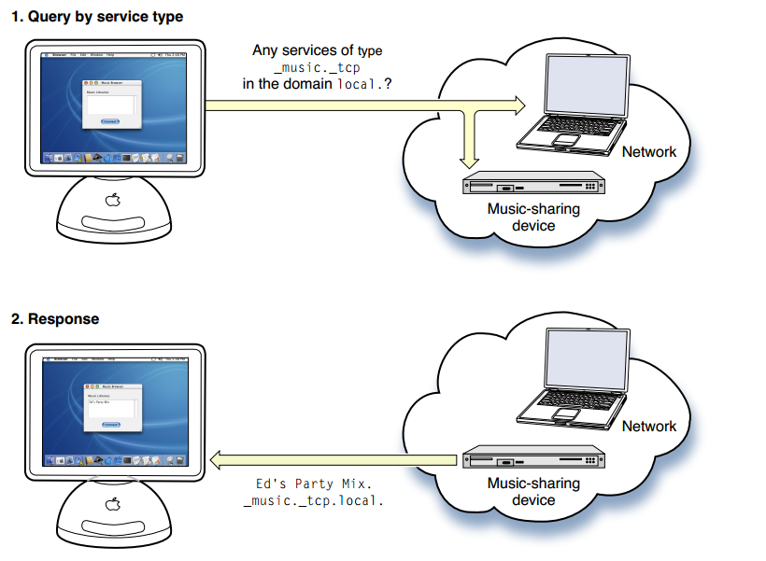
6. Service Discovery Frameworks Bonjour
https://developer.apple.com/library/mac/documentation/Cocoa/Conceptual/NetServices/NetServices.pdf

Slide 61
Index
Introduction
Resource Discovery Architectures
Resource Discovery Techniques
Resource Discovery Methods
Clustering and Overlay Networks
Dedicated Frameworks
Open issues in Resource Discovery
Bibliography

Slide 62
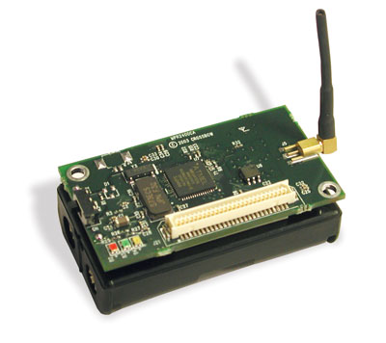
7. Resource Discovery
Challenges
Ad-hoc and Mesh Wireless Network
Decentralized infrastructure
The size of the network spans over a wide range
Heterogeneous devices
Wireless Sensor Networks
Communication media with low bandwidth
Devices with limited memory
No XML parsing allowed
Cost-based algorithm for efficient service discovery

Slide 63
7. Resource Discovery
Challenges
Service Discovery in Smart Environment
To exploit the context-information to refine the search
To push to the clients all the needed services instead of the discovered ones
$𝔻$ = context
C= {$𝔻_{0}, …,𝔻_{n−1}$}, $𝔻_{i}∈𝔻=i−th dimension of the context$
$𝔻_{location},𝔻_{time},𝔻_{environment},𝔻_{physical status},𝔻_{device status}$
$σ_{t}(c_{i})=v∈ℝ^{n}, v=\left(d_{0},..,d_{n−1}\right)$
$μ\left(c_{i}\right)=s, s={\{{adv}_{i},…,{adv}_{k}\}}_{σ_{t}(c_{i})}$

Slide 64
7. Resource Discovery
Challenges
$$𝔻_{s}$$
$$𝔻_{l}$$
$$𝔻_{l}$$
$$σ_{t}(c_{i})$$
$$μ\left(c_{i}\right)$$
$$𝔻_{t}$$
$$𝔻_{e}$$
$$𝔻_{e}$$

Slide 65
7. Resource Discovery
Challenges
Enabling techniques
Resource Discovery and routing are similar problems
To announce a resource vs to announce a route
To query for a service vs to query for a destination
Cross-layer protocols allow to
Piggyback information about the services with the routing protocol
Routing messages are filled with service discovery information
PROS:
To reduce overhead of the RD
To exploit an existing protocol
CONS:
To increase the message size
To modify an existing protocol (ie. AODV)

Slide 66
Bibliography
Surveys
Ververidis, C.N.; Polyzos, G.C.; , "Service discovery for mobile Ad Hoc networks: a survey of issues and techniques," Communications Surveys & Tutorials, IEEE , vol.10, no.3, pp.30-45, Third Quarter 2008
Elena Meshkova, Janne Riihijärvi, Marina Petrova, Petri Mähönen, ” A survey on resource discovery mechanisms, peer-to-peer and service discovery frameworks” Computer Networks 52 (2008) 2097–2128
Mian, A.N.; Baldoni, R.; Beraldi, R.; , "A Survey of Service Discovery Protocols in Multihop Mobile Ad Hoc Networks," Pervasive Computing, IEEE , vol.8, no.1, pp.66-74, Jan.-March 2009
Koen Vanthournout , Geert Deconinck , Ronnie Belmans, “A taxonomy for resource discovery”, Personal and Ubiquitous Computing Journal
Wenge Rong, Kecheng Liu, "A Survey of Context Aware Web Service Discovery: From User's Perspective," sose, pp.15-22, 2010 Fifth IEEE International Symposium on Service Oriented System Engineering, 2010

Slide 67
Bibliography
Resource Discovery Surveys
Zhu, F.; Mutka, M.W.; Ni, L.M.; , "Service discovery in pervasive computing environments," Pervasive Computing, IEEE , vol.4, no.4, pp. 81- 90, Oct.-Dec. 2005
Sivavakeesar, S.; Gonzalez, O.F.; Pavlou, G.; , "Service discovery strategies in ubiquitous communication environments," Communications Magazine, IEEE , vol.44, no.9, pp.106-113, Sept. 2006
W. Keith Edwards, "Discovery Systems in Ubiquitous Computing," IEEE Pervasive Computing, vol. 5, no. 2, pp. 70-77, April-June 2006

Slide 68
Bibliography
Semantic Service Discovery
S Mokhtar, D Preuveneers, N Georgantas, V Issarny, Y Berbers, “EASY: Efficient semAntic Service discoverY in pervasive computing environments with QoS and context support”, Journal of Systems and Software (2007) Volume: 81, Issue: 5, Publisher: Elsevier, Pages: 785-808
Fei Li , Katharina Rasch , Hong-linh Truong , Rassul Ayani , Schahram Dustdar, ” Proactive Service Discovery in Pervasive Environments“
Helal, S.; Desai, N.; Verma, V.; Choonhwa Lee; , "Konark - a service discovery and delivery protocol for ad-hoc networks," Wireless Communications and Networking, 2003. WCNC 2003. 2003 IEEE , vol.3, no.
Klein, M.; Konig-Ries, B.; Obreiter, P.; , "Service rings - a semantic overlay for service discovery in ad hoc networks," Database and Expert Systems Applications, 2003. Proceedings. 14th International Workshop on , vol., no., pp. 180- 185, 1-5 Sept. 2003
Juan Ignacio Vázquez, and Diego López de Ipiña, “mRDP: An HTTP-based lightweight semantic discovery protocol.”, Computer Networks, Vol. 51, Nr. 16 (2007) , p. 4529-4542.
Bellavista, P.; Corradi, A.; Montanari, R.; Toninelli, A.; , "Context-aware semantic discovery for next generation mobile systems," Communications Magazine, IEEE , vol.44, no.9, pp.62-71, Sept. 2006
Chakraborty, D.; Joshi, A.; Yesha, Y.; Finin, T.; , "Toward Distributed service discovery in pervasive computing environments," Mobile Computing, IEEE Transactions on , vol.5, no.2, pp. 97- 112, Feb. 2006

Slide 69
Bibliography
Cross-layer protocols
Rae Harbird, “Adaptive Resource Discovery for Ubiquitous Computing”, In Proceedings of the 2 nd Workshop on Middleware for pervasive and ad-hoc computing
Ververidis, C.N.; Polyzos, G.C.; , "AVERT: Adaptive SerVicE and Route Discovery ProTocol for MANETs," Networking and Communications, 2008. WIMOB '08. IEEE International Conference on Wireless and Mobile Computing, , vol., no., pp.38-43, 12-14 Oct. 2008
Service Discovery Architectures
Dhanakoti, N.; Gopalan, S.; Sridhar, V.; Subramani, S.; , "A distributed service discovery and selection framework in pervasive service environments," Telecommunications, 2005. advanced industrial conference on telecommunications/service assurance with partial and intermittent resources conference/e-learning on telecommunications workshop. aict/sapir/elete 2005. proceedings , vol., no., pp. 452- 457, 17-20 July 2005
Yuanmin Chen; Wei Mao; Xiaodong Li; , "Federation framework for service discovery in ubiquitous computing," Communication Technology, 2008. ICCT 2008. 11th IEEE International Conference on , vol., no., pp.600-602, 10-12 Nov. 2008
ZHANG Li, SHI Zhen-lian, SHEN Qi, "A Service Discovery Architecture based on Anycast in Pervasive Computing Environments," compsac, vol. 2, pp.101-108, 2007 31st Annual International Computer Software and Applications Conference, 2007

Slide 70
Bibliography
Service Discovery Frameworks
SLP E. Guttman et al., “Service Location Protocol, Version 2,” IETFRFC 2608, June 1999
UPnP: Microsoft Corporation, “Universal Plug and Play: Background”;http://www.upnp.org/resources/UPnPbkgnd.htm, 1999.
Salutation: Salutation Consortium, “Salutation Architecture Specification”;http://web.archive.org/web/20030623193812/www.salutation.org/, 1999 (the Salutation Consortium was disbanded on June 30, 2005).
Bluetooth: “Specification of the Bluetooth System”; http://www.bluetooth.com, Dec. 1999.

Slide 71
Backup slides

Slide 72
3. RD Techniques Query Termination
Chasing wave
A number of query replicas are sent toward the neighbours
For every hop the query leaves a marker in order to keep trace of path
As soon as the query is received, the client sends a number of chasing packets in order to kill the running queries

Slide 73
5. Clustering and overlay networks Super Node Clustering
Given the graph, a number of nodes are elected with the role of Cluster Heads (CH)
CHs collect partial information about the available resources
The queries are forwarded to the a CHs that can reply differently:
by forwarding the query to the provider
by answering on behalf of the provider

Slide 74
5. Clustering and overlay networks Super Node Clustering issues
The election of CHs require to share and to evaluate the function/non-functional properties of the candidates (resource computation, load factor, hw features)
A node acting as CH can pass the role to another node dynamically
The CHs generate non-negligible amount of traffic due to:
Synchronization of CHs about the available resource
Election and maintenance of the CHs

Slide 75
5. Clustering and overlay networks Examples of clusters
Tree-based clustering
CHs are arranged as a tree.
Locality and Logical Clustering
Nodes are clustered on the basis of
Distance in terms of number of hops
Type of resource provided: all the
$$q_{k}$$

Slide 76
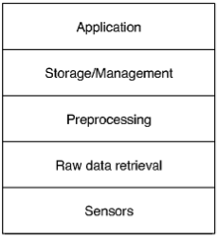
7. Resource Discovery Challenges
implements the sensing tasks
organizes the data collected providing
a sync. or async. interaction
aggregates and combines data from
different context-sources
hides low-level sensing details
physical sensor
virtual sensor
logical sensor
Notes:
forse

